Slide 1
Lasso model specifications

Slide 2
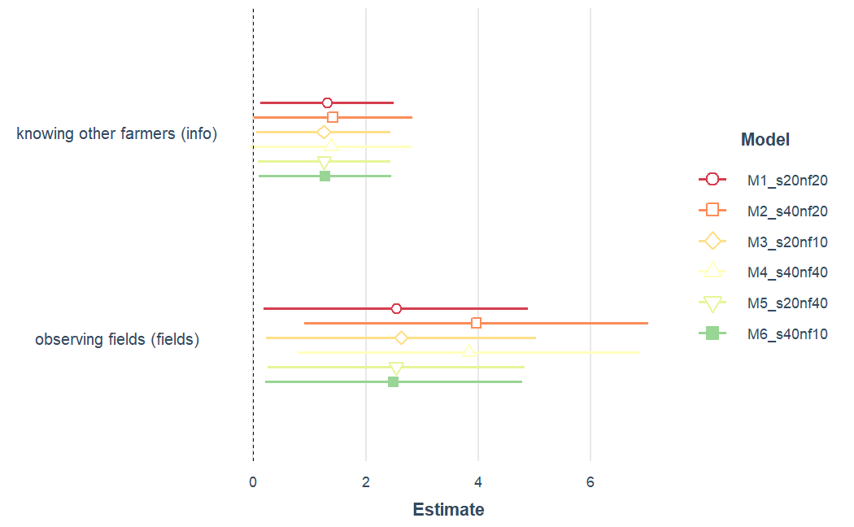
Different seeds and nfolds

Slide 3
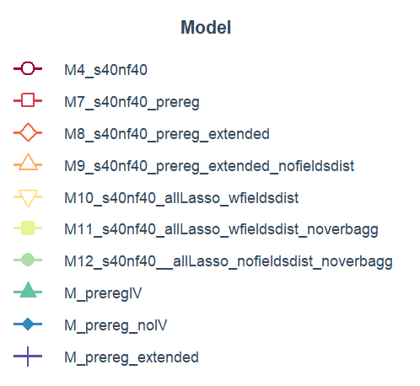
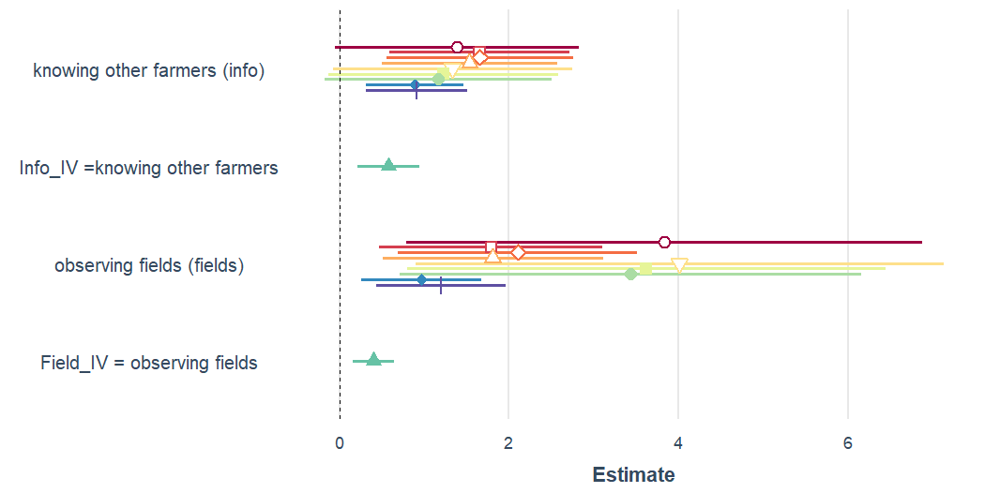
Different set of variables
Restricted set of vars as in pre-reg
old models = no lasso

Slide 4
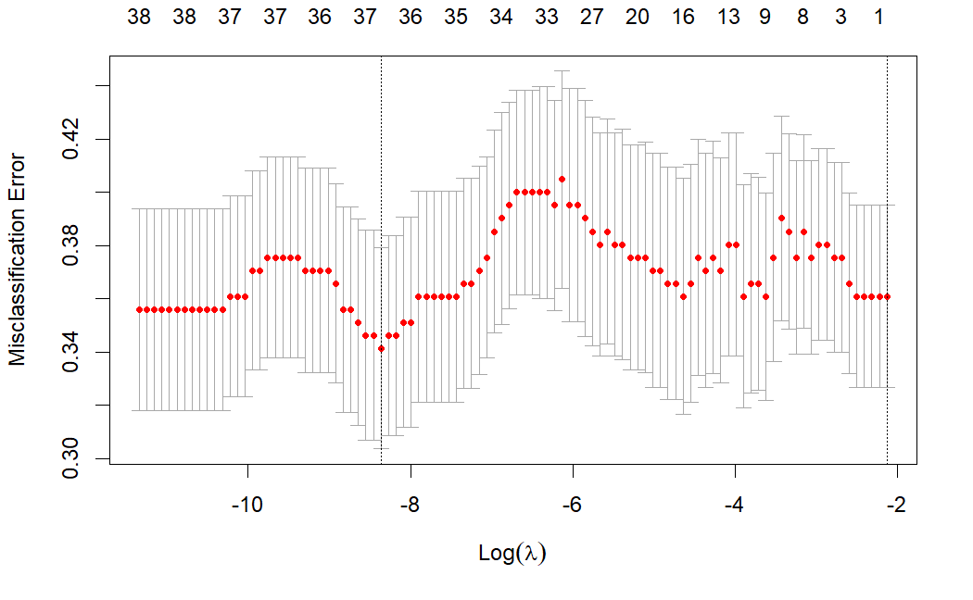
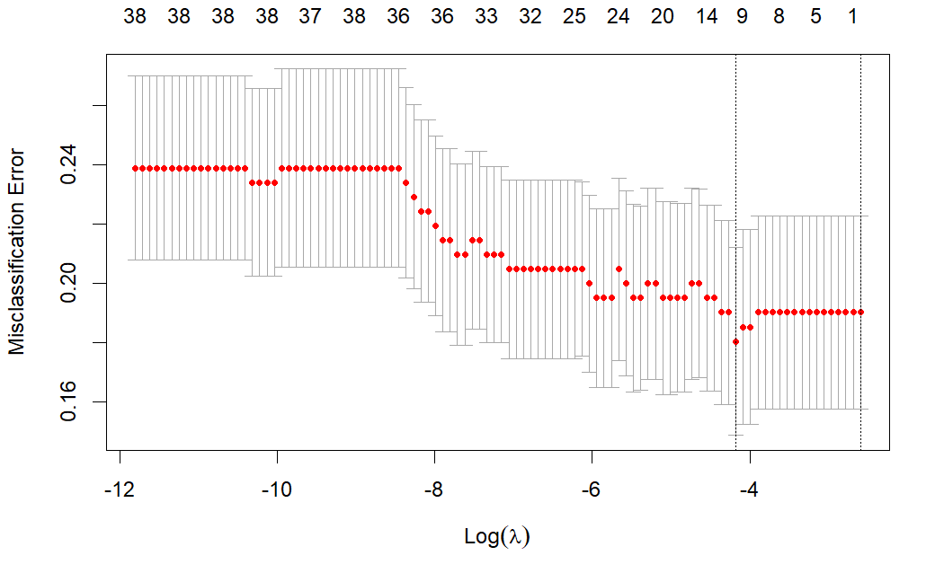
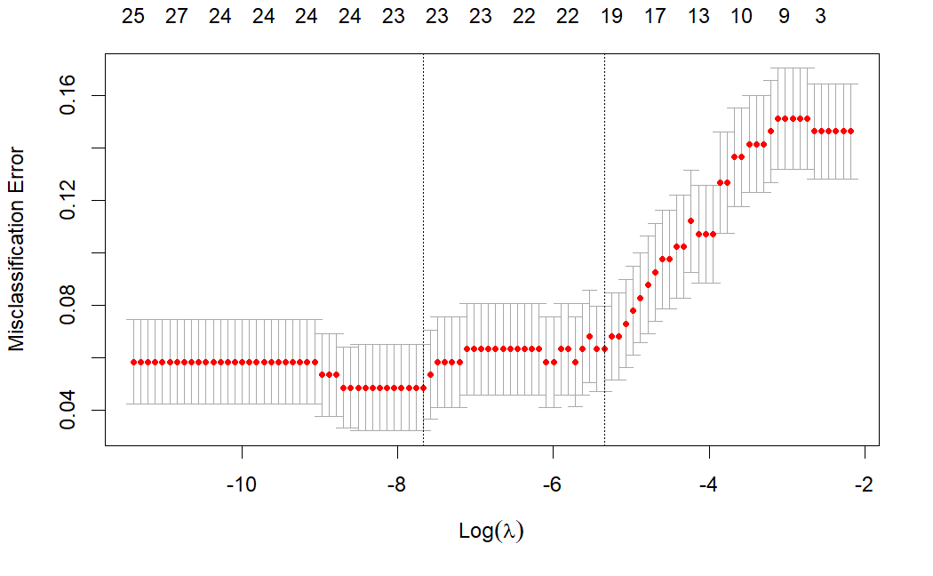
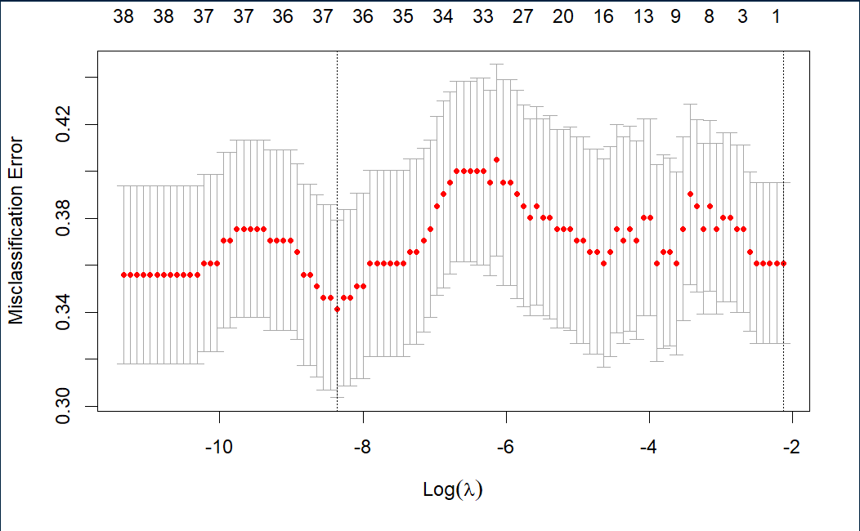
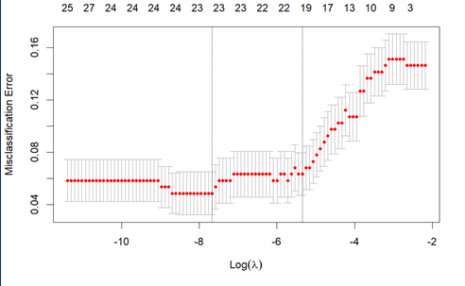
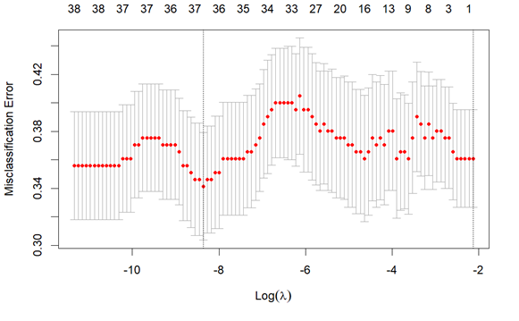
final set up: seed40, nfold40, all Lasso fieldsdist
Step 1: adoption | Step 2: info | Step 3. fields
Where does the peak come from? | The less vars included, the lower the error e.g. only few vars help to explain info | The less vars included, the higher error, e.g. vars help to explain fields
 | Info excluded
 |  | Field excluded

Slide 5
Vars selected in 12 different models
 | variable | n
1 | q_adopt | 12
2 | minDist_demo | 12
3 | AES_b | 12
4 | age_b | 12
5 | fields_b | 12
6 | info_b | 12
7 | Fabrikstandort_agg | 11
8 | farmsize_b | 11
9 | sand_content_percent_mean | 11
10 | farm_organic | 9
11 | ShareSB | 9
12 | lwBetr_Anzahl | 9
13 | UAA_Organic | 9
14 | population | 9
15 | populationdensity | 9
16 | areaDens | 9
17 | ShareSmallFarms | 9
18 | sq.sand_content_percent_mean | 9
19 | SB_region | 8
20 | UAA_Sugarbeet | 7
21 | sq.demodist | 7
22 | meanFarmSize2 | 7
23 | elevation_in_m_mean | 7
24 | UAA_unter5 | 6
25 | clay_content_percent_mean | 6
26 | lwBetrOrganic_Anzahl | 5
27 | lwBetrUnter5_Anzahl | 5
28 | lwBetr5b_Anzahl | 5
29 | ShareOrgFarms | 5
30 | farmDens | 5
31 | sq.elevation_in_m_mean | 5
32 | fields_dist | 5
33 | mainly_crop | 4
34 | Verband_agg | 4
35 | UAA | 4
36 | UAA_arable | 4
37 | ShareOrgArea | 4
38 | sq.clay_content_percent_mean | 4
39 | sq.fields_dist | 4
40 | UAA_5b | 3
41 | Area | 1
Model13
Model14

Slide 6
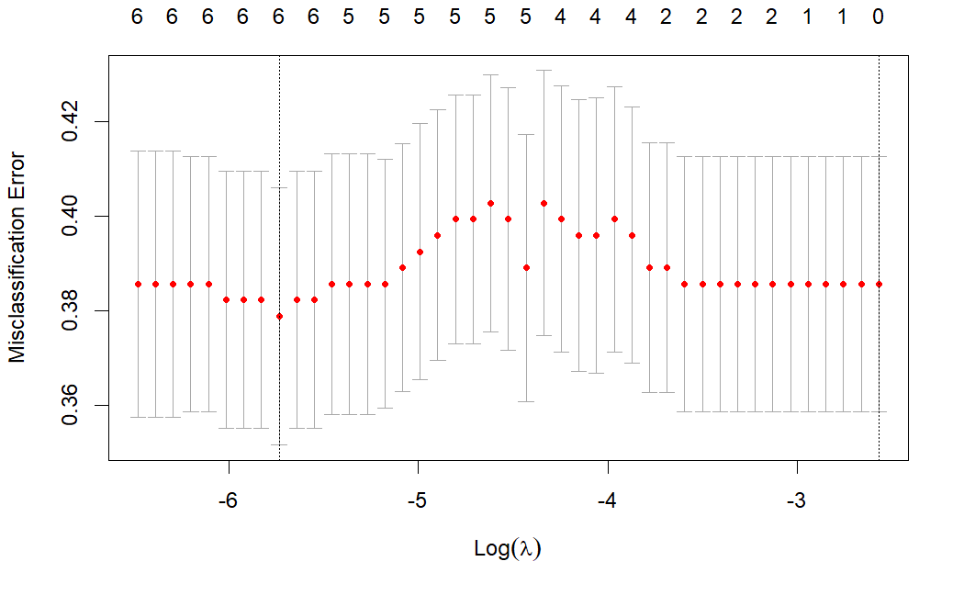
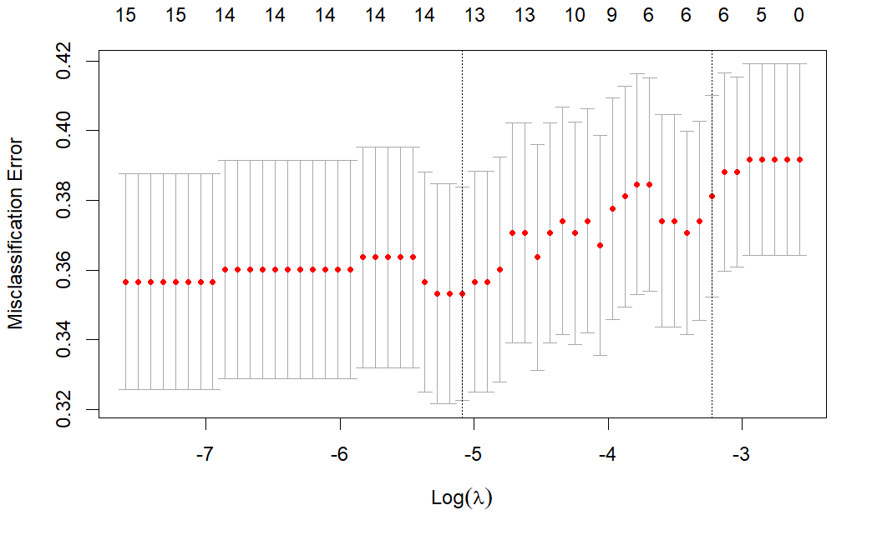
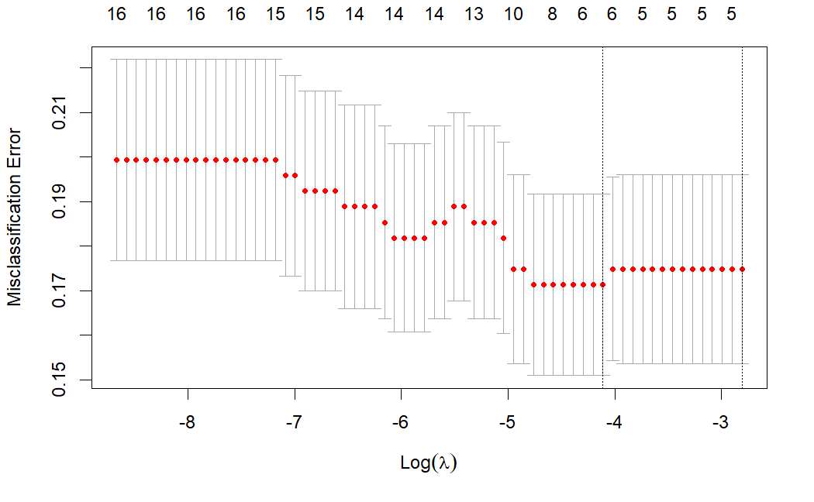
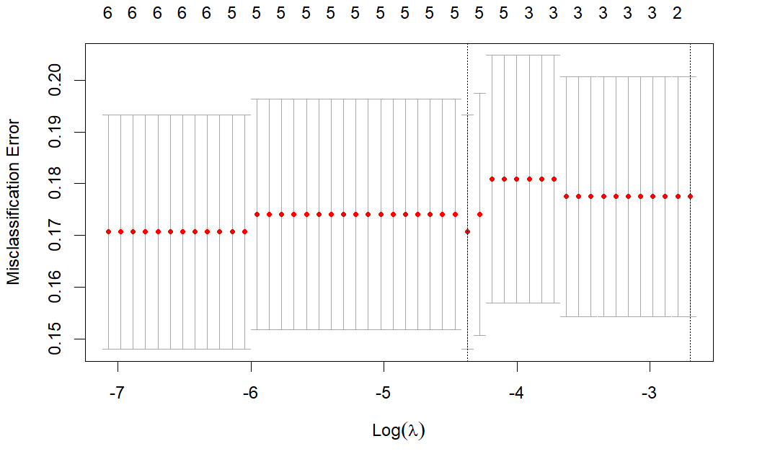
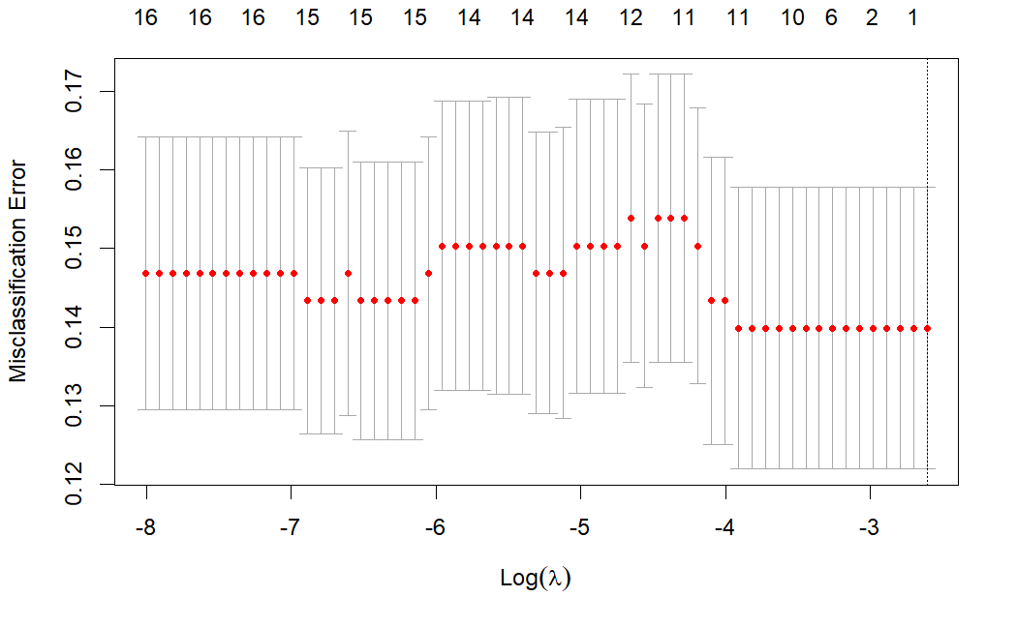
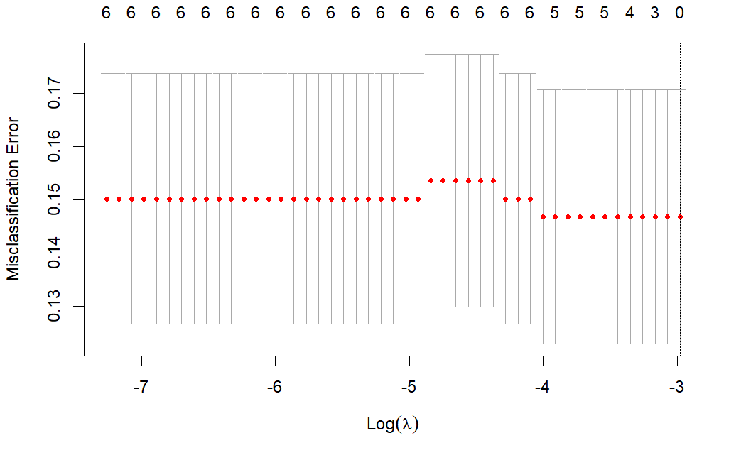
Model 13 Model 14

Slide 7
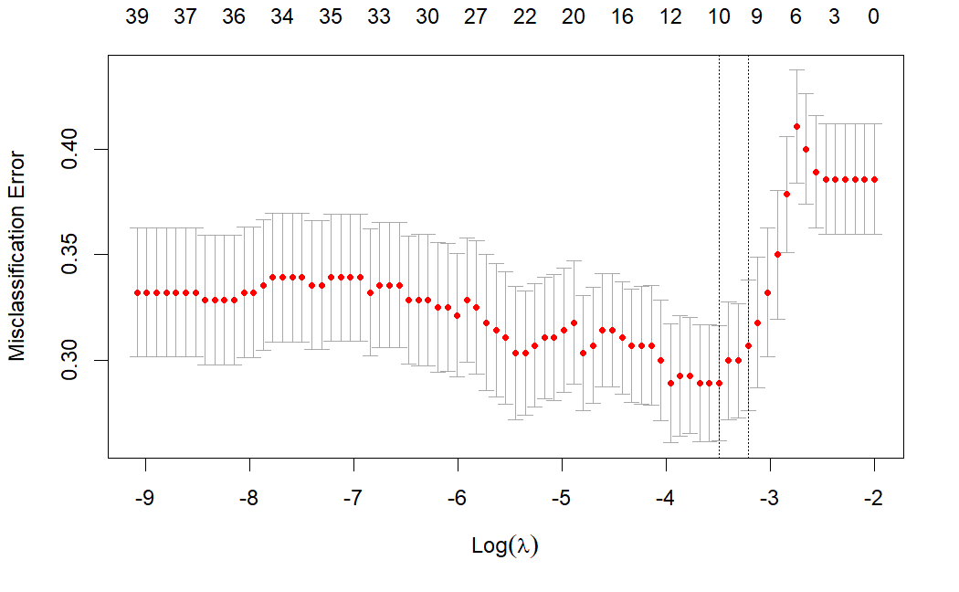
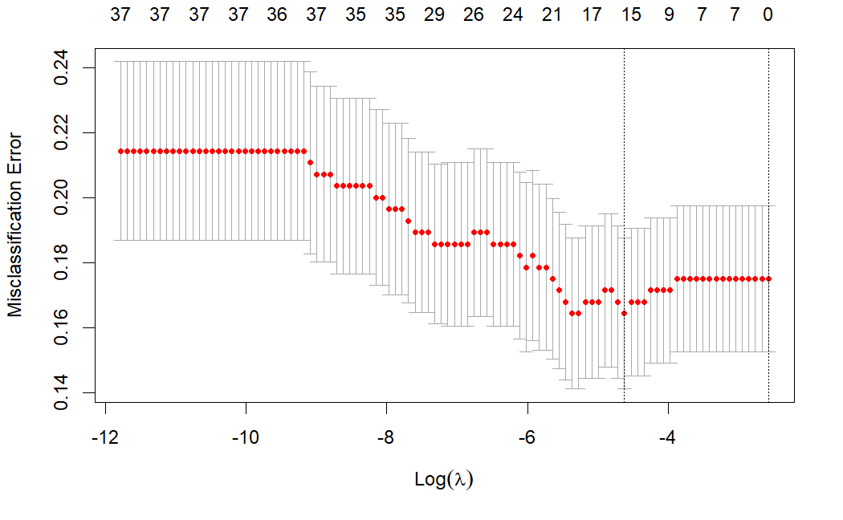
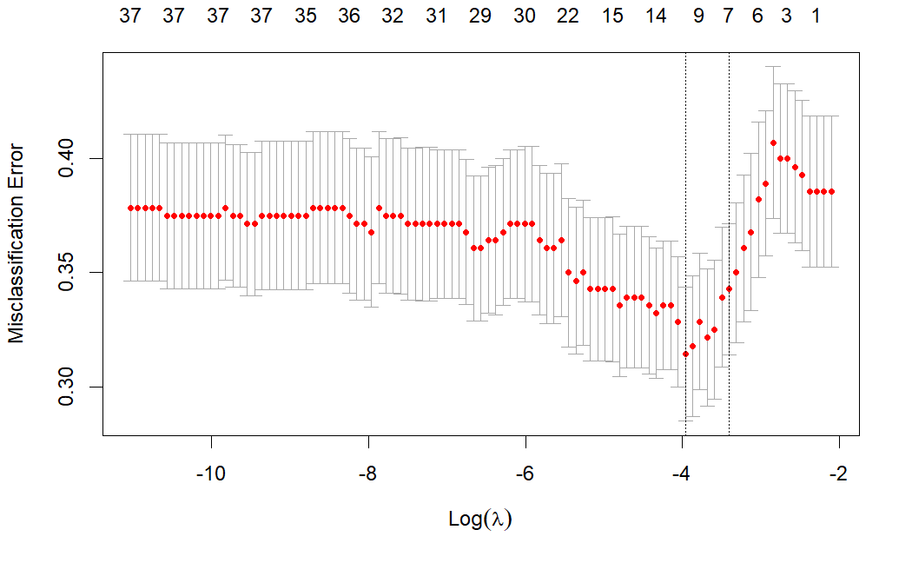
All Lasso, N = 280
Adoption
Info
Fields

Slide 8
 | Pre-reg | Pre-reg IV | Pre-reg extended with regional vars based on economic intuition | Lasso selected (M14) (30 out of 39)
1 | Info_b | Info_b | Info_b | info_b
2 | fields_b | fields_b | fields_b | fields_b
5 | minDist_demo | minDist_demo | minDist_demo | minDist_demo
6 | sq.demodist | sq.demodist | sq.demodist
7 | age_b | age_b | age_b | age_b
8 | farmsize_b | farmsize_b | farmsize_b | farmsize_b
9 | AES_b | AES_b | AES_b | AES_b
10 | Fabrikstandort_agg | Fabrikstandort_agg | Fabrikstandort_agg | Fabrikstandort_agg
11 | FieldDist | ShareOrgFarms (IV1) |  | ShareOrgFarms
12 | FieldDist^2 | ShareOrgArea (IV2)
13 |  |  | SB_region | SB_region
14 |  |  | meanFarmSize2 | meanFarmSize2
15 |  |  | sand_content_percent_mean | sand_content_percent_mean
16 |  |  | elevation_in_m_mean | elevation_in_m_mean
17 |  |  |  | sq.elevation_in_m_mean
18 |  |  |  | sq.sand_content_percent_mean
19 |  |  |  | mainly_crop
20 |  |  |  | areaDens
21 |  |  |  | lwBetr_Anzahl
22 |  |  |  | ShareSmallFarms
23 |  |  |  | clay_content_percent_mean
24 |  |  |  | sq.clay_content_percent_mean
25 |  |  |  | lwBetrUnter5_Anzahl
26 |  |  |  | farm_organic
27 |  |  |  | UAA_5b10
28 |  |  |  | UAA_Organic
29 |  |  |  | Area population
30 |  |  |  | Verband_agg

Slide 9
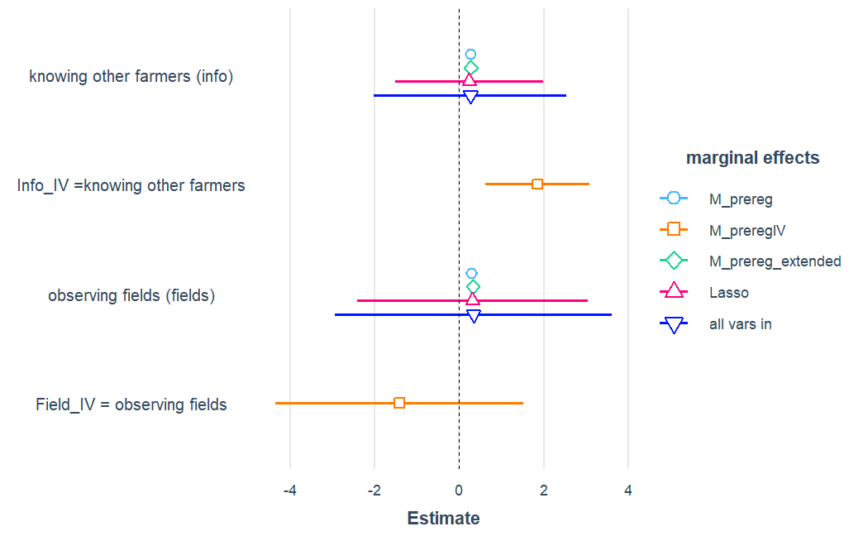
N = 291
N = 280 (due to missing values for county level data)

Slide 10
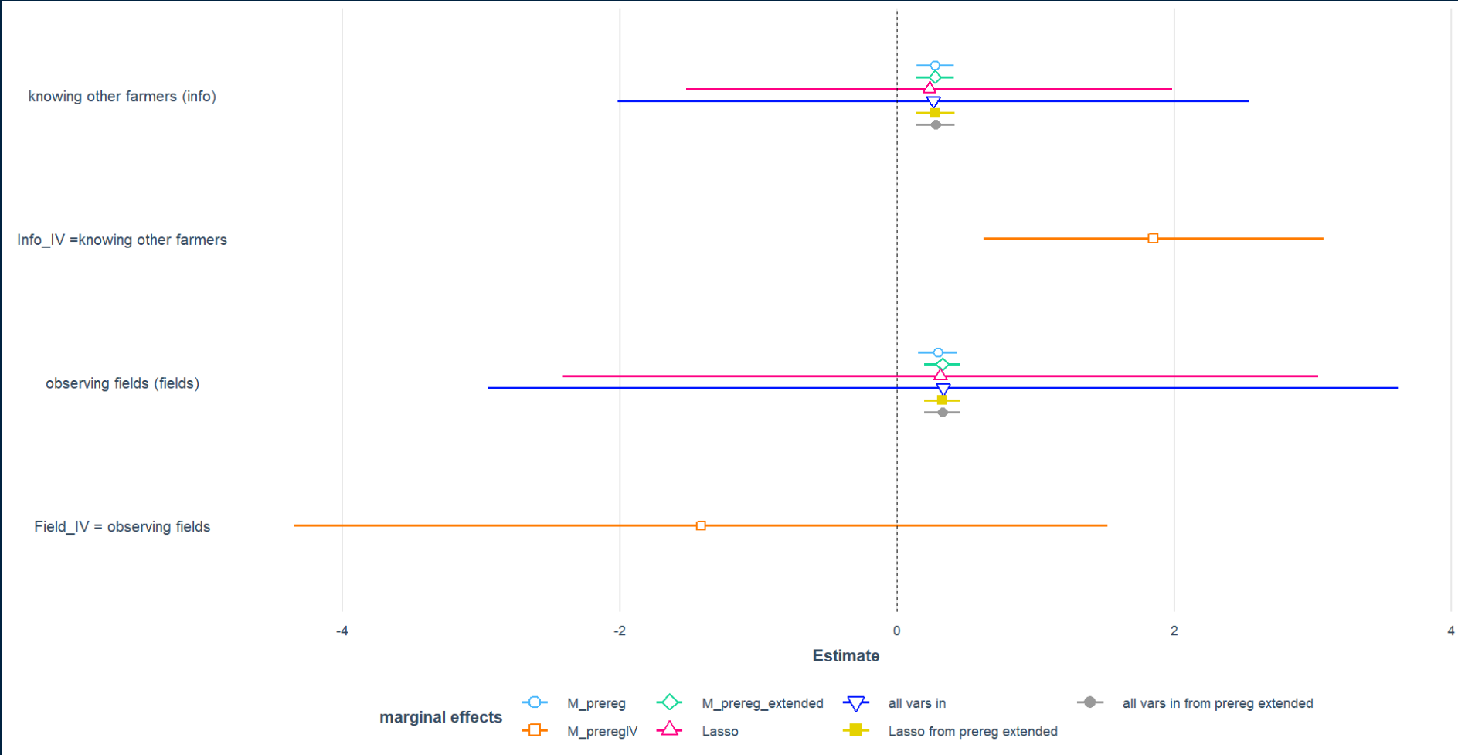

Slide 11
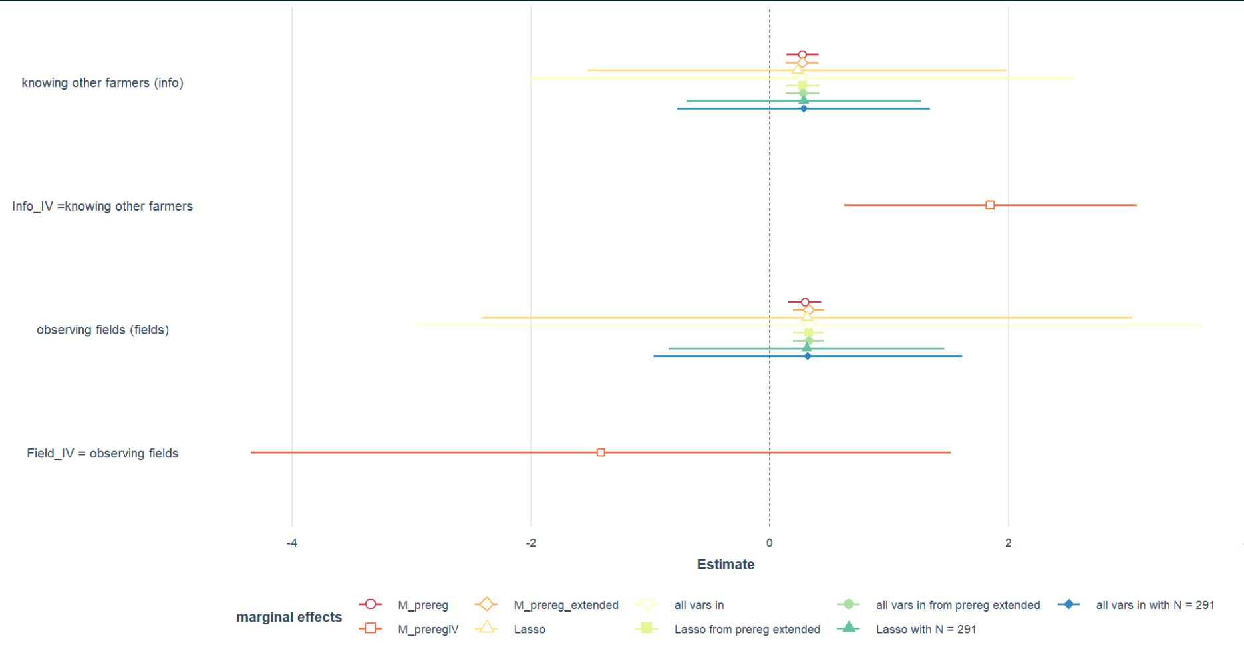

Slide 12
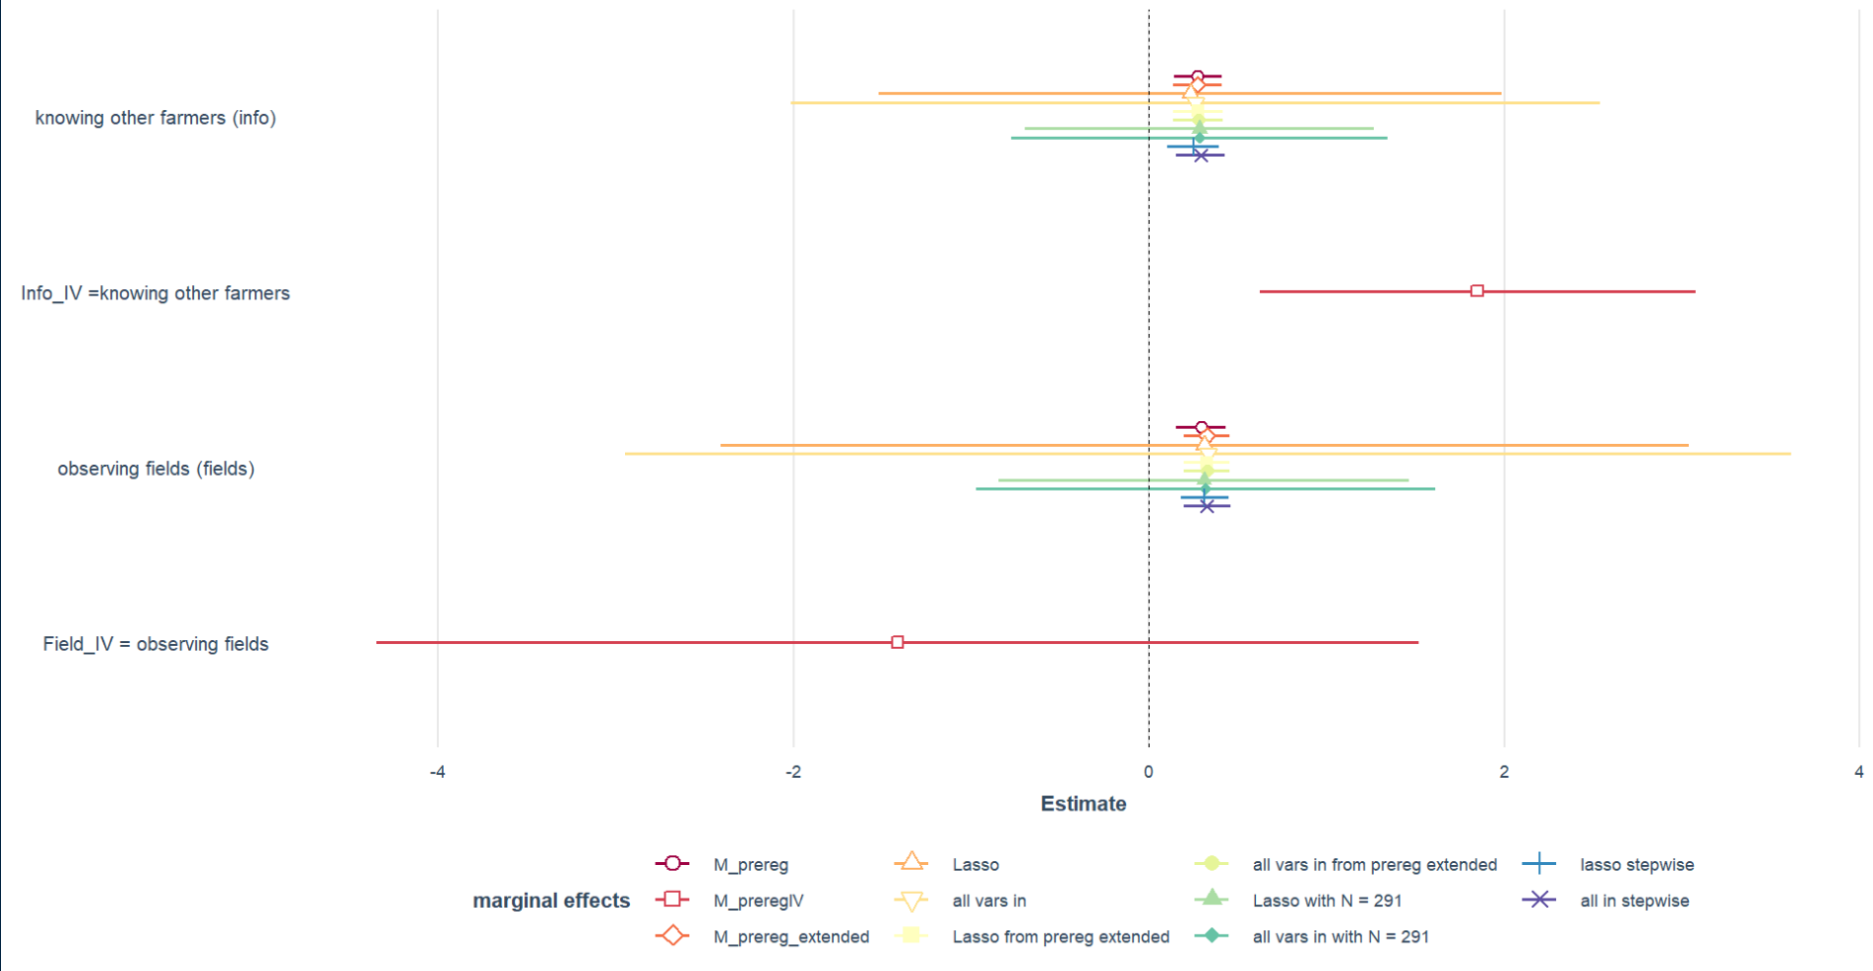
All vars in except verband_agg and those with many missing values (e.g. UAA_unter5,UUA_5b10)

Slide 13
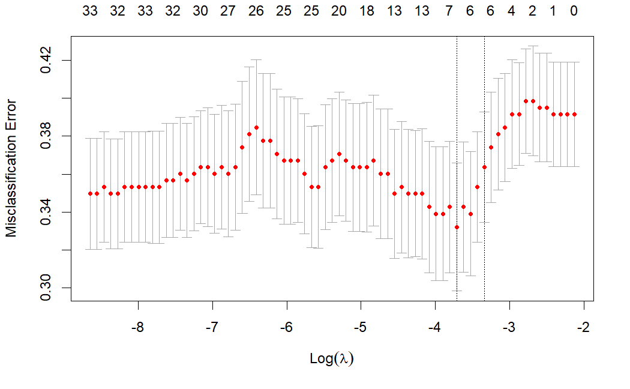
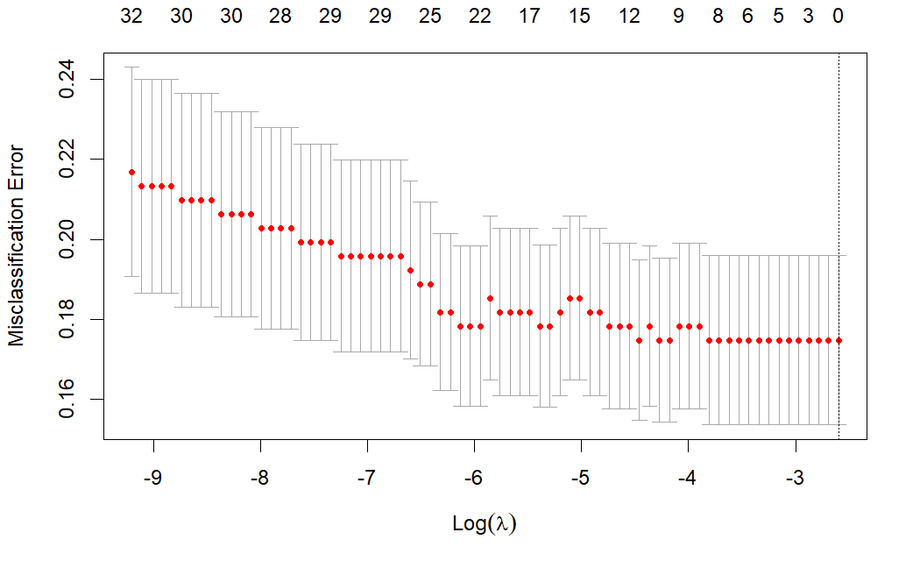
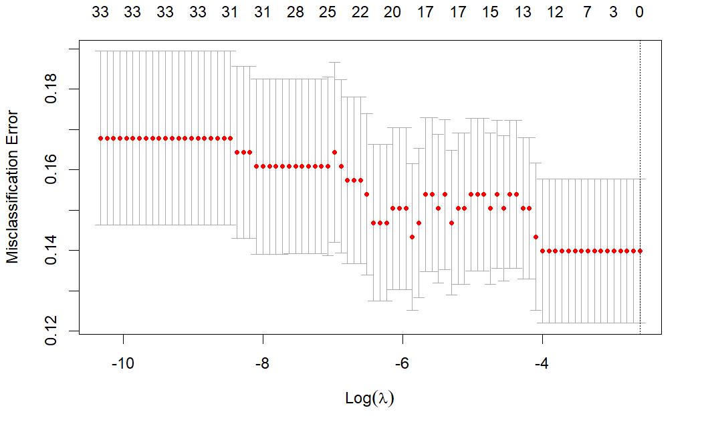
Final model

Slide 14
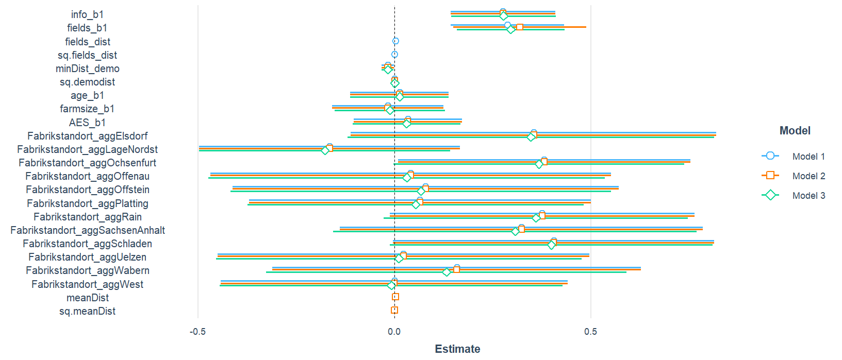
How should distance to fields observed enter?

